Slide 1

TCP: Transmission Control Protocol SCC. 203 – Computer Networks
Chapters 3.4 & 3.5
15 February, 2022
Vasileios Giotsas
Session Code: 843684
Notes:
In today’s lecture we’re going to look at TCP, in the previous lecture Matt covered transport protocols and UDP, today we’re going to look at TCP as a reliable protocol.
If you look at the schedule for the course there’s actually two lectures on this, today I’m going to start with the principles and the basic fundamentals of TCP, the mechanisms within it and in the next lecture on Tuesday we’re going to look at congestion control of TCP which is kind of a core aspect of the protocol.
So remember that now we look at the underlying protocols below the application layer, we looked at things like web, DNS, email and now we look at what enables the transport of the application data.

Slide 2
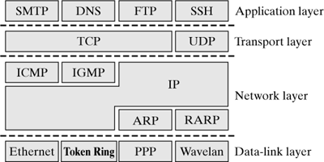
What layer is ICMP?
RFC 792: “ICMP uses the basic support of IP as if it were a higher-level protocol, however, ICMP is actually an integral part of IP, and must be implemented by every IP module.”
Wehrle, Klaus, F. Pahlke, and D. Muller. "Linux Networking Architecture: Design and Implementation of Networking Protocols in the Linux Kernel, 2004."

Slide 3
Introduction: Reliable Data Transfer What is reliability?
Reliability: the degree to which the result of a measurement, calculation, or specification can be depended on to be accurate
We need it in computer networks when:
We want to ensure a remote operation has been successful
We want to guarantee the ordering of operations on a remote client
We want to know that an operation has been lost or failed
Notes:
So back to TCP! TCP is the de-facto transport protocol used for *reliable* data transfer
If we think about what reliability means in this case, according to the dictionary is “the degree to which the result of a measurement, calculation or specification can be depended on to be accurate”
What does that mean for computing networks? When we want a computing network to be reliable what are we looking for?
We want to ensure that a remote operation has been successful
We want to ensure the ordering of remote operations which is very important if you things like banking or if you book a flight ticket.
And we want to know when an operation has failed.
So we want guarantees regarding the reliability and the ordering of operations, and TCP has been implemented with these guarantees in mind.

Slide 4
Introduction: Reliable Data Transfer Why is it important?
Important in many different layers:
Application
Transport
Link
But how do we build a reliable data transfer protocol when the channel underneath (the network) is inherently unreliable?
The characteristics of this unreliable channel will determine complexity of a reliable data transfer protocol
Notes:
Reliable data transfer is important in many different layers.
Since applications run on top of TCP, they can depend on TCP for the reliability of their communication.
But TCP runs on top of an inherently unreliable layer, the network layer, which offers what we call a best-effort service.
So TCP cannot depend on the network layer for reliability, instead it includes a set of complex steps to build a reliable channel on top of an unreliable network.

Slide 5
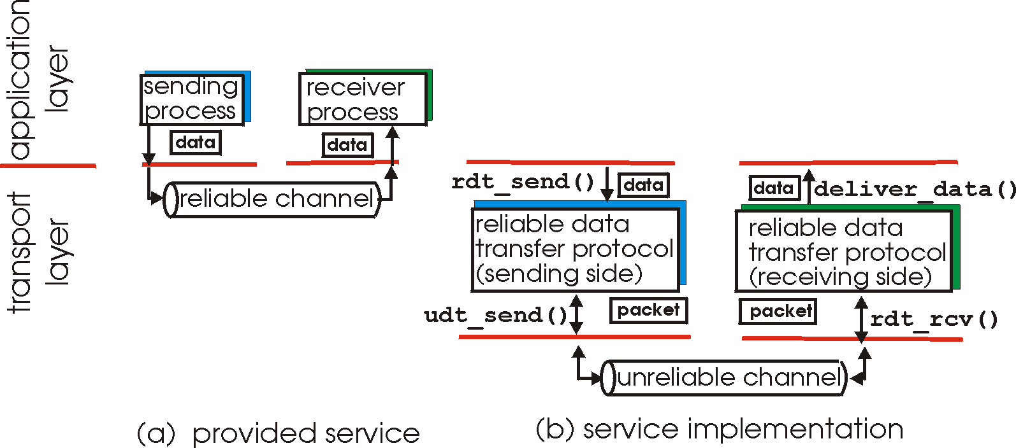
Reliable Data Transfer Perspective: Application Layer
Notes:
So if you think about what a reliable data transfer looks like from a very general perspective
Say you build a web server for example, you have a sending process and the application doesn’t care about what mechanisms exist underneath.
This is why we have these abstraction layers, to simplify development and take away the complexity.
So the sending process just pushes data down the pipe, and we just determine that we need a reliable transmission so that we know the data are going to arrive at the receiver process eventually, and in the correct order as well.

Slide 6
Reliable Data Transfer Perspective: Transport Layer
rdt: Reliable Data Transfer
udt: Unreliable Data Transfer
Notes:
How to implement that in reality is a little bit different.
So lets say we’re using first a function called reliable data send (rdt_send) which invokes the mechanisms that allow this process to happen.
In the data link layer the unreliable channel still exists, as we said many times the Internet is an unreliable best-effort network, it makes no promises whether or not your packet will go from your server that may be in America to your phone here in Lancaster, or at what order it will arrive.
Despite how the Internet is built, to ensure that we’re going to get reliability we build the reliable data transfer protocol on top of that.
In this case you have to have a protocol on either side, remember protocols are used to allow interoperability between different devices, so if my sending device doesn’t use the same reliable transfer protocol as my receiving device I won’t be able to get reliable transmission between the two end hosts.
So this is what a reliable data transfer protocol looks like from a very generic perspective

Slide 7
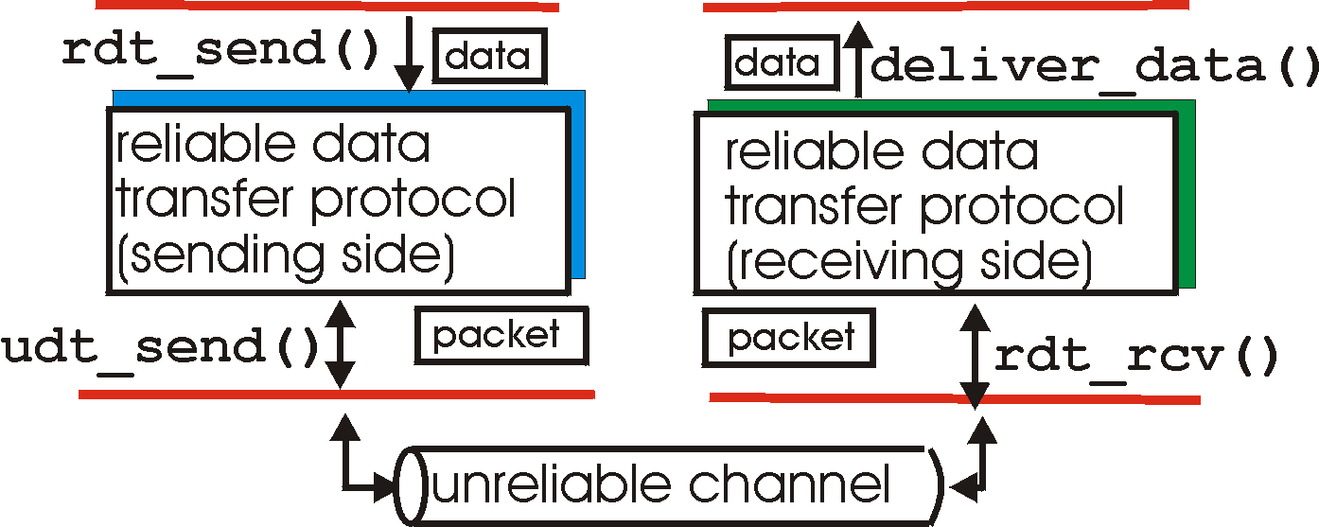
Reliable Data Transfer Perspective: Transport Layer
rdt_send(): called from above, (e.g., by app.). Passed data to
deliver to receiver upper layer
deliver_data(): called by rdt to deliver data to upper
send
side
receive
side
udt_send(): called by rdt,
to transfer packet over
unreliable channel to receiver
rdt_rcv(): called when packet arrives on rcv-side of channel
Notes:
So lets see that in a bit more detail.
So the reliable data transfer send is called from the application which passes data to the application-layer receiver
The unreliable data transfer send at the bottom sits below the transfer protocol to send the data over the unreliable channel.
It doesn’t really matter what that unreliable channel is, it might be the wider Internet or a wireless device connected to another wireless device, the bottom line is that the transfer protocol makes no assumptions about the underlay channel.
And again, it receives the data back up from the unreliable channel and then the reliable data transfer protocol delivers calls the deliver data function to pull the data and pass them to the application.

Slide 8
Transmission Control Protocol Overview
Notes:
Like I said, these are only abstractions that allow us not to worry about the specific details, imagine every time you’re building a web server or a web client imagine having to implement each of those reliable data transfer protocols, it would be very time consuming and costly. Instead we have these standards that we can use across applications and devices to allow reliable data transfer.
TCP is the most common of reliable data transfer protocols, it’s used very widely in the Internet.

Slide 9
TCP: Overview RFCs: 793,1122,1323, 2018, 2581
Point-to-point:
One sender, one receiver
Reliable, in-order byte steam:
No “message boundaries”
Pipelined:
TCP congestion and flow control set window size
Notes:
If you have trouble sleeping tonight and you need some help get yourself knocked off check out the RFCs, but the main things to remember is that TCP is a point-to-point protocol, so TCP in itself involves only one sender and one receiver. There are extensions to this operational mode to allow multicast and anycast but the actual protocol is point-to-point.
It offers a reliable in-order byte stream, so there’s no boundaries between the messages
It’s also pipelined, which means that we can send a large number of packets and keep them in the pipeline until we receive an acknowledgment. The size of this pipeline is referred to as the window size, and the size of the TCP window is dynamic to control traffic flows and congestion.

Slide 10
TCP: Overview RFCs: 793,1122,1323, 2018, 2581
Full duplex data:
Bi-directional data flow in same connection
MSS: maximum segment size
Connection-oriented:
Handshaking (exchange of control messages) initiates sender, receiver state before data exchange
Flow controlled:
sender will not overwhelm receiver
Notes:
It’ full duplex, which means that data can flow in either direction of the same connection and it has a maximum data size that restricts the amount of data that we can send
It’s connection oriented, which means that there’s some notion of a connection between the client and the server.
To do this we use a handshaking process which is an exchange of messages that prepare the sender and the receiver to be in the correct states, and negotiates in some cases what that connection should look like before any data should be sent over it.
Finally, it’s flow-controlled which means that the sender control the rate of data flows in order not to overwhelm the receiver.

Slide 11
TCP Segment Structure
URG: urgent data
(generally not used)
counting
by bytes
of data
(not segments!)
source port #
dest port #
sequence number
ACK: ACK #
valid
acknowledgement number
head
len
not
used
U
receive window
A
PSH: push data now
(generally not used)
P
R
S
F
# bytes
rcvr willing
to accept
checksum
Urg data pointer
RST, SYN, FIN:
connection estab
(setup, teardown
commands)
options (variable length)
application
data
(variable length)
Internet
checksum
(as in UDP)
Notes:
Now lets look a bit at the TCP segment header.
It has the source and destination ports at the top
For instance in the web server client you bind your server to a specific port and your client should query that port in order to communicate with your server or your proxy.
The sequence and acknowledgment numbers help with ensuing ordering and data delivery, we will examine how they work shortly.
We also have some important flags that are critical for the handshake process, flags have a length of just one bit so their value can be either zero or one.
For instance if a connection finishes the FIN flag is set to 1, otherwise it remains zero.
We have the checksum in there which is calculated in the same way for TCP and UDP.
And after some options of variable length we have the application data, such as the HTTP messages or the payload of any application protocol.

Slide 12
TCP Sequence Numbers ACKs
outgoing segment from sender
source port #
dest port #
sequence number
Sequence numbers:
byte stream “number” of first byte in segment’s data
Acknowledgements:
seq # of next byte expected from other side
cumulative ACK
Q: how receiver handles out-of-order segments
A: TCP spec doesn’t say; up to implementation
acknowledgement number
rwnd
checksum
urg pointer
window size
N
sender sequence number space
sent
ACKed
sent, not-yet ACKed
(“in-flight”)
usable
but not
yet sent
not
usable
incoming segment to sender
source port #
dest port #
sequence number
acknowledgement number
A
rwnd
checksum
urg pointer
Notes:
So here lets pay attention because it can be confusing.
There are two types of numbers, sequence numbers and acknowledgment numbers
The sequence number gives you the number of the first byte in the TCP segment’s data, that’s the data that have been sent.
Acknowledgment number is the sequence number of the next byte expected from the other side.
Remember that TCP is a reliable protocol, so what the sequence and acknowledgment numbers do is try to avoid lost data
The acknowledgments are cumulative which means that if we’ve sent 3 segments and all have been successfully received,
the acknowledgment number can be set at the end of the third segment so that we minimize ack packets.
On the right you can see an example of how those ACKs are used.
In this colored array we represent the sequence address space.
The green are the data that we have sent and acknowledged by the receiver.
The yellow are the data that we have sent but not yet ACKed by the receiver, the so-called in-flight data.
The blue ones are data that have not been sent yet but we have them in the pipeline.
And the red are those that are beyond the sender’s pipeline, which we call the window
As the receiver acknowledges received packet the senders window moves forward so that this red not usable space becomes blue, then yellow and eventually green.

Slide 13
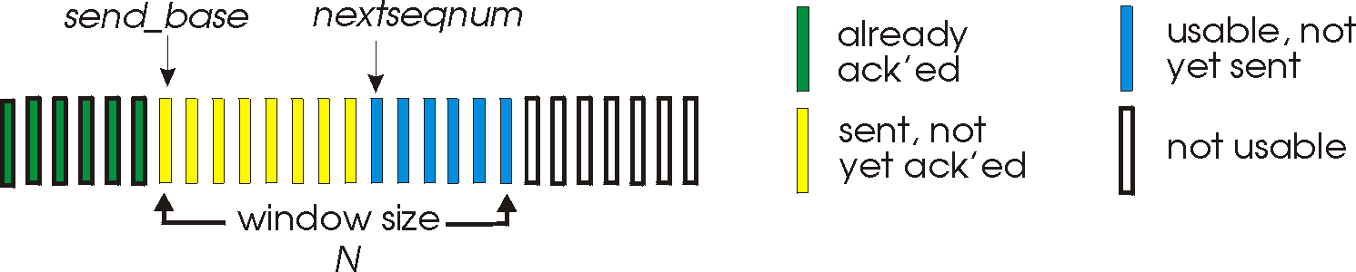
TCP Sequence Numbers Sliding window
k-bit seq # in pkt header
“window” of up to N, consecutive unACKed pkts allowed
ACK(n): ACKs all pkts up to, including seq # n – “cumulative ACK”
may receive duplicate ACKs
timer for oldest in-flight packet
timeout(n): retransmit packet n and all higher seq # packets in window
Notes:
So here lets pay attention because it can be confusing.
There are two types of numbers, sequence numbers and acknowledgment numbers
The sequence number gives you the number of the first byte in the TCP segment’s data, that’s the data that have been sent.
Acknowledgment number is the sequence number of the next byte expected from the other side.
Remember that TCP is a reliable protocol, so what the sequence and acknowledgment numbers do is try to avoid lost data
The acknowledgments are cumulative which means that if we’ve sent 3 segments and all have been successfully received,
the acknowledgment number can be set at the end of the third segment so that we minimize ack packets.
On the right you can see an example of how those ACKs are used.
In this colored array we represent the sequence address space.
The green are the data that we have sent and acknowledged by the receiver.
The yellow are the data that we have sent but not yet ACKed by the receiver, the so-called in-flight data.
The blue ones are data that have not been sent yet but we have them in the pipeline.
And the red are those that are beyond the sender’s pipeline, which we call the window
As the receiver acknowledges received packet the senders window moves forward so that this red not usable space becomes blue, then yellow and eventually green.

Slide 14

TCP Sequence Numbers ACKs
Host A
Host B
User
types
‘C’
Seq=42, ACK=79, data = ‘C’
host ACKs
receipt of
‘C’, echoes
back ‘C’
Seq=79, ACK=43, data = ‘C’
host ACKs
receipt
of echoed
‘C’
Seq=43, ACK=80
Simple telnet scenario
Notes:
So lets see how the sequence and acknowledgment numbers work in the scenario of Telnet, which is a remote command-line terminal.
In this case we just send the character C using TCP from host A to host B.
The Sequence number has been set to 42 and we see we also have an ACK number which means we’re in the middle of a communication and Host A is acknowledging a previous transmission by Host B.
Host B echoes back the ‘C’ character and responds back with an Acknowledgment number that indicates the next sequence number that the server expects.
It’s set to 43 because a character is one byte long so the server received this byte and therefore he expects the next segment to continue with the 43rd byte.
Indeed Host A acknowledges the echoed ‘C’ with ACK 80.

Slide 15
TCP Round Trip Time Timeout
Q: how to set TCP timeout value?
longer than RTT
but RTT varies
too short: premature timeout, unnecessary retransmissions
too long: slow reaction to segment loss
Q: how to estimate RTT?
SampleRTT: measured time from segment transmission until ACK receipt
ignore retransmissions
SampleRTT will vary, want estimated RTT “smoother”
average several recent measurements, not just current SampleRTT
Notes:
So what happens if we don’t receive an ACK? We need a timeout after which if we haven’t received an ack for data we’ve send we assume its lost.
This can be due to overflow of router buffers, or it may be corrupted in transit due to radio frequency interference for example.
So the question is what value should the retransmission TCP timeout have?
Now if we’re connected to a very fast network it may be meaningful to set it to a small value.
But for slower networks or longer-distance communications, a small timeout will cause many unnecessary transmissions, the ACKs may just take a bit longer to arrive.
On the other hand, an unnecessarily long timeout will slow down communications because the reaction to packet loss will be slow.
The problem is that it’s very hard to estimate latency and delay in advance and they also change all the time.
TCP has a dynamic timeout value to adapt to the network conditions.
It first measures the route-trip time from the transmission of a segment to the receipt of an ACK.
Because this RTT will also vary, TCP uses a moving average of several successful transmissions, not just the current RTT

Slide 16
TCP Round Trip Time Timeout
EstimatedRTT:
Exponential weighted moving average
Influence of past sample decreases exponentially fast
Notes:
So here you see an example of how this exponential weighted moving average is used to estimate the RTT and consequently the timeout.
Since we have a weighted moving average it means that the impact of the oldest RTTs becomes less relevant over time

Slide 17
TCP Round Trip Time Timeout
Timeout interval: EstimatedRTT plus “safety margin”
Large variation in EstimatedRTT -> larger safety margin
Notes:
In reality we also add a safety margin on top of the estimated RTT which is based on the standard deviation of the RTT.

Slide 18
Transmission Control Protocol Reliable Data Transfer

Slide 19
TCP Reliable Data Transfer (RDT)
TCP creates RDT service on top of IP’s unreliable service
Pipelined segments
Cumulative acks
Single retransmission timer
Retransmissions triggered by:
Timeout events
Duplicate acks
Let’s initially consider simplified TCP sender:
Ignore duplicate acks
Ignore flow control, congestion control
Notes:
So as we said, TCP builds a reliable data service on top of IP’s unreliable service.
To do this we have pipelined segments, cumulative ACKs and the retransmission timer.
As I explained the retransmission is triggered by timeouts but also due to duplicate ACKs.
To understand why lets first consider a simple TCP sender and ignore the other complex TCP functions.

Slide 20
TCP Sender Events
Data received from app:
Create segment with seq #
Seq # is byte-stream number of first data byte in segment
Start timer if not already running
Think of timer as for oldest unacked segment
Expiration interval: TimeOutInterval
Notes:
So lets see at what happens at the sender.
First TCP receives the data from an application, and creates a segment with a sequence number
The sequence number is the first data byte in that segment.
It transmits the segment and starts the timeout.

Slide 21
TCP Sender Events
Timeout:
Retransmit segment that caused timeout
Restart timer
Acknowledgement received:
If ack acknowledges previously unacked segments
Update what is known to be ACKed
Start timer if there are still unACKed segments
Notes:
If a timeout happens, the oldest unacknowledged segment is retransmitted and TCP restarts the timeout.
If an acknowledgment is received then TCP updates the timeout for the unacked segments

Slide 22
TCP Retransmission Scenarios
Host A
Host B
Host A
Host B
SendBase=92
Seq=92, 8 bytes of data
Seq=92, 8 bytes of data
timeout
timeout
Seq=100, 20 bytes of data
ACK=100
X
ACK=100
ACK=120
Seq=92, 8 bytes of data
Seq=92, 8
bytes of data
SendBase=100
SendBase=120
ACK=100
ACK=120
SendBase=120
Lost ACK scenario
Premature timeout
Notes:
So lets see some retransmission scenarios.
The first one is a lost ACK scenario.
Host A sends 8 bytes of data to host B with a sequence number of 92.
Because host B received 8 bytes the ACK number is set to 100
However, in this case on the left ACK is lost somewhere in the network so host A waits for a response until the timeout is triggered.
So the same segment is retransmitted with the same sequence number.
After the retransmission the ACK is successfully received so now Host A knows reliably that the data has been delivered.
On the right example we have a scenario of a premature timeout.
Host A sends two packets, first one with sequence of 92 of 8 bytes length, and the second with sequence number of 100 with 20 bytes length.
The SendBase number keeps track of how far in the data we have gone so far in the transmission.
But what’s happened here is that we’ve set a too small timeout and although the ACKs are received they’re received after the timeout has expired.
So Host A resends the first segment.
Notice that we get an ACK back for 120, not for 100.
So TCP understands that this is a duplicate packet and as a result host B asks for the data after byte 120 so that Host A doesn’t retransmit the second segment as well.

Slide 23
TCP Retransmission Scenarios
Host A
Host B
Seq=92, 8 bytes of data
Seq=100, 20 bytes of data
timeout
ACK=100
X
ACK=120
Seq=120, 15 bytes of data
Cumulative ACK
Notes:
In this scenario, Host A sends again two packets, the same two packets as in the last scenario
This time, the first ACK is lost but the second ACK arrives successfully.
The sender understands that the first ACK was lost because the second ACK was for 120, since ACKs are cumulative.
So the next transmission is for a new segment with a sequence number of 120.

Slide 24
TCP ACK Generation [RFC 1122, RFC 2581]
Event at receiver
Arrival of in-order segment with
expected seq #. All data up to
expected seq # already ACKed
Arrival of in-order segment with
expected seq #. One other
segment has ACK pending
Arrival of out-of-order segment
higher-than-expect seq. # .
Gap detected
Arrival of segment that
partially or completely fills gap
TCP receiver action
Delayed ACK. Wait up to 500ms
for next segment. If no next segment,
send ACK
Immediately send single cumulative
ACK, ACKing both in-order segments
Immediately send duplicate ACK,
indicating seq. # of next expected byte
Immediate send ACK, provided that
segment starts at lower end of gap
Notes:
In reality ACK generation can be even more complex.
For example if the receiver receives segments already ACKed instead of sending back ACKs immediately it assumes that the ACKs may be still in transit and to avoid duplicate ACKs it delays the new ACK.

Slide 25
TCP Fast Retransmit
Time-out period often relatively long:
Long delay before resending lost packet
Detect lost segments via duplicate ACKs
Sender often sends many segments back-to-back
If segment is lost, there will likely be many duplicate ACKs
TCP Fast Retransmit
If sender receives 3 ACKs for same data
(“triple duplicate ACKs”), resend unacked segment with smallest seq #
likely that unacked segment lost, so don’t wait for timeout
(“triple duplicate ACKs”),

Slide 26
TCP Fast Retransmit
Host A
Host B
Seq=92, 8 bytes of data
Seq=100, 20 bytes of data
X
ACK=100
Fast retransmit after sender
receipt of triple duplicate ACK
timeout
ACK=100
ACK=100
ACK=100
Seq=100, 20 bytes of data

Slide 27
Transmission Control Protocol Flow Control

Slide 28
TCP Flow Control
application
process
application may
remove data from
TCP socket buffers ….
application
TCP socket
receiver buffers
OS
… slower than TCP
receiver is delivering
(sender is sending)
TCP
code
flow control
IP
code
receiver controls sender, so sender won’t overflow receiver’s buffer by transmitting too much, too fast
from sender
Receiver protocol stack
Notes:
TCP also allows to control the flow of application data being sent.
So we have the application process at the top that’s pushing data down the TCP socket, and that’s also reading from the TCP socket
The receiver application may be slower than the sender application, so to avoid overflowing the receiver’s buffer, the receiver controls the rate of data at which the sender transmits.
This mechanisms is part of TCP

Slide 29
TCP Flow Control
Receiver “advertises” free buffer space by including rwnd value in TCP header of receiver-to-sender segments
RcvBuffer size set via socket options (typical default is 4096 bytes)
many operating systems autoadjust RcvBuffer
sender limits amount of unACKed (“in-flight”) data to receiver’s rwnd value
guarantees receive buffer will not overflow
to application process
RcvBuffer
buffered data
rwnd
free buffer space
TCP segment payloads
Receiver-side buffering
rwnd:receiver window
Notes:
To control flow, the receiver includes an rwnd value in the TCP header to inform the sender of its free buffer space
The sender limits the amount of unacknowledged segments based on the receivers rwnd value.
Note that the receiver buffer is specified on the socket options and many operating systems may auto-adjust it based on the available memory.

Slide 30
TCP flow control
application
process
Q: What happens if network layer delivers data faster than application layer removes data from socket buffers?
Application removing data from TCP socket buffers
TCP socket
receiver buffers
TCP
code
Network layer delivering IP datagram payload into TCP socket buffers
IP
code
from sender
receiver protocol stack
Notes:
(Presuming an intro)
Before diving into the details of TCP flow control, let’s first get the general context and motivate the need for flow control.
This diagram show a typical transport-layer implementation
A segment is brought up the protocol stack to the transport layer, and the segment’s payload is removed from the segment and written INTO socket buffers.
How does data get taken OUT of socket buffers? By applications performing socket reads, as we learned in Chapter 2.
And so the question is “What happens if network layer delivers data faster than an application-layer process removes data from socket buffers?”
Let’s watch a video of what happens when things arrive way too fast to fast to be processed.
<video>. (I love that video). Another human analogy showing the need for flow control is the saying – to use some English slang - “no one can drink from a firehose”
Flow control is a mechanism to the calamity of a receiver being over-run by a sender that is sending too fast – it allows the RECEIVER to explictly control the SENDER so sender won’t overflow receiver’s buffer by transmitting too much, too fast

Slide 31

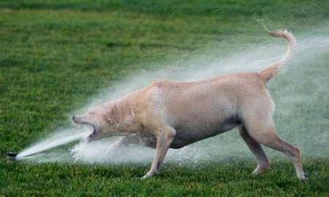
TCP flow control
application
process
Q: What happens if network layer delivers data faster than application layer removes data from socket buffers?
Application removing data from TCP socket buffers
TCP socket
receiver buffers
TCP
code
Network layer delivering IP datagram payload into TCP socket buffers
IP
code
from sender
receiver protocol stack
Notes:
(Presuming an intro)
Before diving into the details of TCP flow control, let’s first get the general context and motivate the need for flow control.
This diagram show a typical transport-layer implementation
A segment is brought up the protocol stack to the transport layer, and the segment’s payload is removed from the segment and written INTO socket buffers.
How does data get taken OUT of socket buffers? By applications performing socket reads, as we learned in Chapter 2.
And so the question is “What happens if network layer delivers data faster than an application-layer process removes data from socket buffers?”
Let’s watch a video of what happens when things arrive way too fast to fast to be processed.
<video>. (I love that video). Another human analogy showing the need for flow control is the saying – to use some English slang - “no one can drink from a firehose”
Flow control is a mechanism to the calamity of a receiver being over-run by a sender that is sending too fast – it allows the RECEIVER to explictly control the SENDER so sender won’t overflow receiver’s buffer by transmitting too much, too fast

Slide 32
TCP flow control
application
process
Q: What happens if network layer delivers data faster than application layer removes data from socket buffers?
Application removing data from TCP socket buffers
TCP socket
receiver buffers
TCP
code
receive window
flow control: # bytes receiver willing to accept
IP
code
from sender
receiver protocol stack
Notes:
(Presuming an intro)
Before diving into the details of TCP flow control, let’s first get the general context and motivate the need for flow control.
This diagram show a typical transport-layer implementation
A segment is brought up the protocol stack to the transport layer, and the segment’s payload is removed from the segment and written INTO socket buffers.
How does data get taken OUT of socket buffers? By applications performing socket reads, as we learned in Chapter 2.
And so the question is “What happens if network layer delivers data faster than an application-layer process removes data from socket buffers?”
Let’s watch a video of what happens when things arrive way too fast to fast to be processed.
<video>. (I love that video). Another human analogy showing the need for flow control is the saying – to use some English slang - “no one can drink from a firehose”
Flow control is a mechanism to the calamity of a receiver being over-run by a sender that is sending too fast – it allows the RECEIVER to explictly control the SENDER so sender won’t overflow receiver’s buffer by transmitting too much, too fast

Slide 33
TCP flow control
application
process
Q: What happens if network layer delivers data faster than application layer removes data from socket buffers?
Application removing data from TCP socket buffers
TCP socket
receiver buffers
flow control
TCP
code
receiver controls sender, so sender won’t overflow receiver’s buffer by transmitting too much, too fast
IP
code
from sender
receiver protocol stack
Notes:
(Presuming an intro)
Before diving into the details of TCP flow control, let’s first get the general context and motivate the need for flow control.
This diagram show a typical transport-layer implementation
A segment is brought up the protocol stack to the transport layer, and the segment’s payload is removed from the segment and written INTO socket buffers.
How does data get taken OUT of socket buffers? By applications performing socket reads, as we learned in Chapter 2.
And so the question is “What happens if network layer delivers data faster than an application-layer process removes data from socket buffers?”
Let’s watch a video of what happens when things arrive way too fast to fast to be processed.
<video>. (I love that video). Another human analogy showing the need for flow control is the saying – to use some English slang - “no one can drink from a firehose”
Flow control is a mechanism to the calamity of a receiver being over-run by a sender that is sending too fast – it allows the RECEIVER to explictly control the SENDER so sender won’t overflow receiver’s buffer by transmitting too much, too fast

Slide 34
TCP flow control
TCP receiver “advertises” free buffer space in rwnd field in TCP header
RcvBuffer size set via socket options (typical default is 4096 bytes)
many operating systems autoadjust RcvBuffer
sender limits amount of unACKed (“in-flight”) data to received rwnd
guarantees receive buffer will not overflow
to application process
RcvBuffer
buffered data
rwnd
free buffer space
TCP segment payloads
TCP receiver-side buffering
Notes:
Here’s how TCP implement flow control. The basic idea is simple – the receiver informs the sender how much free buffer space there is, and the sender is limited to send no more than this amount of data. That the value o RWND in the diagram to the right.
This information is carried from the receiver to the sender in the “receiver advertised window” (do a PIP of header) in the TCP header, and the value will change as the amount of free buffer space fluctuates over time.

Slide 35
TCP flow control
flow control: # bytes receiver willing to accept
TCP receiver “advertises” free buffer space in rwnd field in TCP header
RcvBuffer size set via socket options (typical default is 4096 bytes)
many operating systems autoadjust RcvBuffer
sender limits amount of unACKed (“in-flight”) data to received rwnd
guarantees receive buffer will not overflow
receive window
TCP segment format
Notes:
Here’s how TCP implement flow control. The basic idea is simple – the receiver informs the sender how much free buffer space there is, and the sender is limited to send no more than this amount of data. That the value o RWND in the diagram to the right.
This information is carried from the receiver to the sender in the “receiver advertised window” (do a PIP of header) in the TCP header, and the value will change as the amount of free buffer space fluctuates over time.

Slide 36
TCP connection management
before exchanging data, sender/receiver “handshake”:
agree to establish connection (each knowing the other willing to establish connection)
agree on connection parameters (e.g., starting seq #s)
application
application
connection state: ESTAB
connection variables:
seq # client-to-server
server-to-client
rcvBuffer size
at server,client
connection state: ESTAB
connection Variables:
seq # client-to-server
server-to-client
rcvBuffer size
at server,client
network
network
Socket clientSocket =
newSocket("hostname","port number");
Socket connectionSocket = welcomeSocket.accept();
Notes:
The other TCP topic we’ll want to consider here is that of “connection management”
The TCP sender and reciver have a number of pieces of shared state that they must establish before actually communication
FIRST theym ust both agree that they WANT to communicate with each other
Secondly there are connection parameters – the initial sequence number and the initial receiver-advertised bufferspace that they’ll want to agree on
This is done via a so-called handshake protocol – the client reaching our to the server, and the server answering back.
And before diving into the TCP handshake protocol, let’s first consider the problem of handshaking, of establishing shared state.

Slide 37


Agreeing to establish a connection
2-way handshake:
Q: will 2-way handshake always work in network?
variable delays
retransmitted messages (e.g. req_conn(x)) due to message loss
message reordering
can’t “see” other side
Let’s talk
OK
ESTAB
ESTAB
choose x
req_conn(x)
acc_conn(x)
ESTAB
ESTAB
Notes:
Here’s an example of a two way handshake. Alice reaches out to Bob and say’s “let’s talk” and Bob says OK, and they start their conversation
For a network protocol, the equivalent protocol would be a client sending a “request connection” message saying ”let’s talk, the initial sequence number is x”
And the server would respond with a message ”I accept your connect x”
And the question we want to ask ourselves is <talk through>
Will this work? Let’s look at a few scenarios…

Slide 38

2-way handshake scenarios
choose x
req_conn(x)
ESTAB
acc_conn(x)
ESTAB
data(x+1)
accept
data(x+1)
ACK(x+1)
connection
x completes
No problem!

Slide 39

2-way handshake scenarios
choose x
req_conn(x)
ESTAB
retransmit
req_conn(x)
acc_conn(x)
ESTAB
req_conn(x)
connection
x completes
client terminates
server
forgets x
ESTAB
acc_conn(x)
Problem: half open connection! (no client)

Slide 40
2-way handshake scenarios
choose x
req_conn(x)
ESTAB
retransmit
req_conn(x)
acc_conn(x)
ESTAB
data(x+1)
accept
data(x+1)
retransmit
data(x+1)
connection
x completes
client terminates
server
forgets x
req_conn(x)
ESTAB
data(x+1)
accept
data(x+1)
Problem: dup data
accepted!

Slide 41
TCP 3-way handshake
Server state
Client state
serverSocket = socket(AF_INET,SOCK_STREAM)
serverSocket.bind((‘’,serverPort))
serverSocket.listen(1)
connectionSocket, addr = serverSocket.accept()
clientSocket = socket(AF_INET, SOCK_STREAM)
LISTEN
clientSocket.connect((serverName,serverPort))
LISTEN
choose init seq num, x
send TCP SYN msg
SYNSENT
SYNbit=1, Seq=x
choose init seq num, y
send TCP SYNACK
msg, acking SYN
SYN RCVD
SYNbit=1, Seq=y
ACKbit=1; ACKnum=x+1
received SYNACK(x)
indicates server is live;
send ACK for SYNACK;
this segment may contain
client-to-server data
ESTAB
ACKbit=1, ACKnum=y+1
received ACK(y)
indicates client is live
ESTAB
Notes:
TCP’s three way handshake, that operates as follows
Let’s say the client and server both create a TCP socket as we learned about in Chapter 2 and enter the LISTEN state
The client then connects to the server sending a SYN message with a sequence number x (SYN Message is an TCP Segment with SYN but set in the header – you might want to go back and review the TCP segment format!)
The server is waiting for a connection, and receives the SYN message enters the SYN received state (NOT the established state and sends a SYN ACK message back.
Finally the client sends an ACK message to the server, and when the server receiver this enters the ESTABLished state. This is when the application process would see the return from the wait on the socket accept() call

Slide 42
TCP Closing a Connection
Client, server each close their side of connection
Send TCP segment with FIN bit = 1
Respond to received FIN with ACK
On receiving FIN, ACK can be combined with own FIN
Simultaneous FIN exchanges can be handled
Notes:
Similarly TCP needs a handshake to terminate a connection safely.
In that case another flag within the header is used, the FIN flag
And the receivers responds with the FIN and ACK flags set

Slide 43
TCP Closing a Connection
client state
server state
ESTAB
ESTAB
clientSocket.close()
FIN_WAIT_1
can no longer
send but can
receive data
FINbit=1, seq=x
CLOSE_WAIT
ACKbit=1; ACKnum=x+1
can still
send data
FIN_WAIT_2
wait for server
close
LAST_ACK
FINbit=1, seq=y
TIMED_WAIT
can no longer
send data
ACKbit=1; ACKnum=y+1
timed wait
for 2*max
segment lifetime
CLOSED
CLOSED

Slide 44

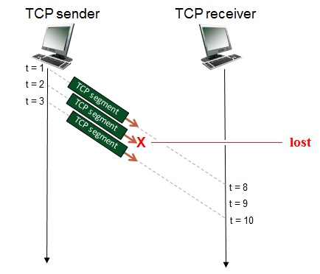

Go to www.menti.com and use the code 3065 0744
The TCP sender sends initial window of three segments. Suppose the initial value of the sender-to-receiver sequence number is 132 and the first three segments each contain 501 bytes.
Give the sequence number of segment 3

Slide 45
Thanks for listening! Any questions?
v.giotsas@lancaster.ac.uk

